Slide 1

Pedro Raimundo
Pegasystems
Setting the bar high – important tools to advance your tech career

Slide 2
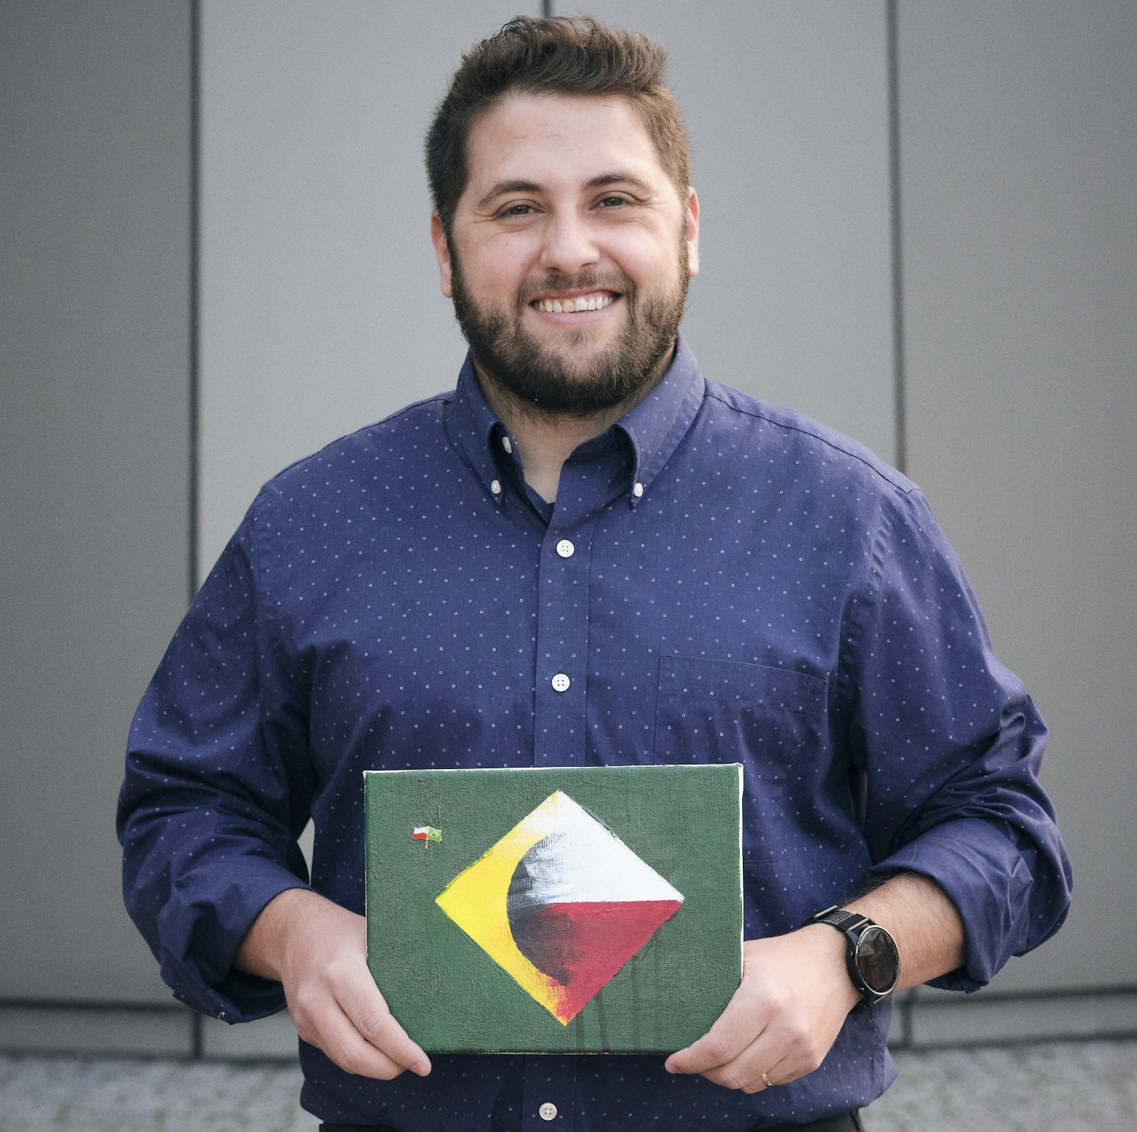
PEDRO
RAIMUNDO
Pegasystems
Manager, Cloud Engineering

Slide 3

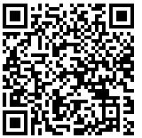
Pega
Cloud
Check out our opportunities :)

Slide 4

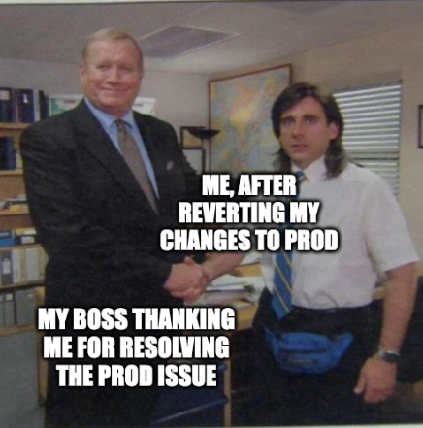
Setting the bar HIGH!
Important tools to advance your tech career

Slide 5
Our quest today
Try ONE new thing from this talk in the next 30 days
…and then, measure the results

Slide 6





Who is this presentation for?
If you feel stagnated/stuck
If you want to advance faster
If you want new ideas to grow
If you are starting with tech
If you want to help your peers
If you like good memes ¯\_(ツ)_/¯

Slide 7
„Career Advancement”
Firstly, let’s define that Career success can translate in many ways, and it is mostly personal
EXERCISE TIME!

Slide 8
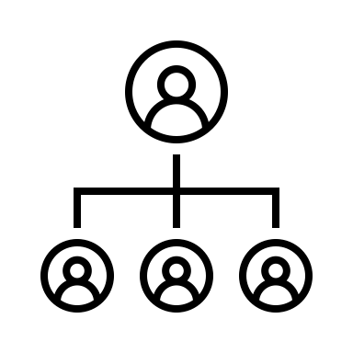


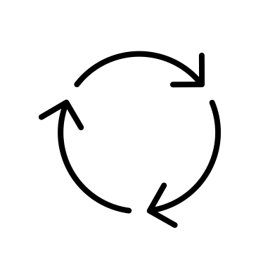


„Career Advancement”
Recognition?
Better salary?
Latest tech stack?
All of those?
Bigger impact?
NONE of those?
! IDENTIFY YOURS !

Slide 9
(Intrinsically or Extrinsically)
It depends on what motivates YOU
And that’s why we will explore different areas today

Slide 10

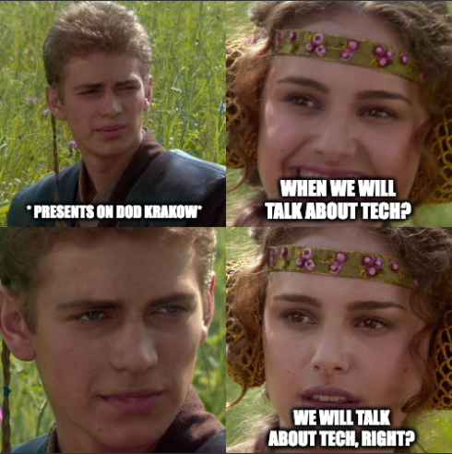
But, wait! This is a tech conference!

Slide 11
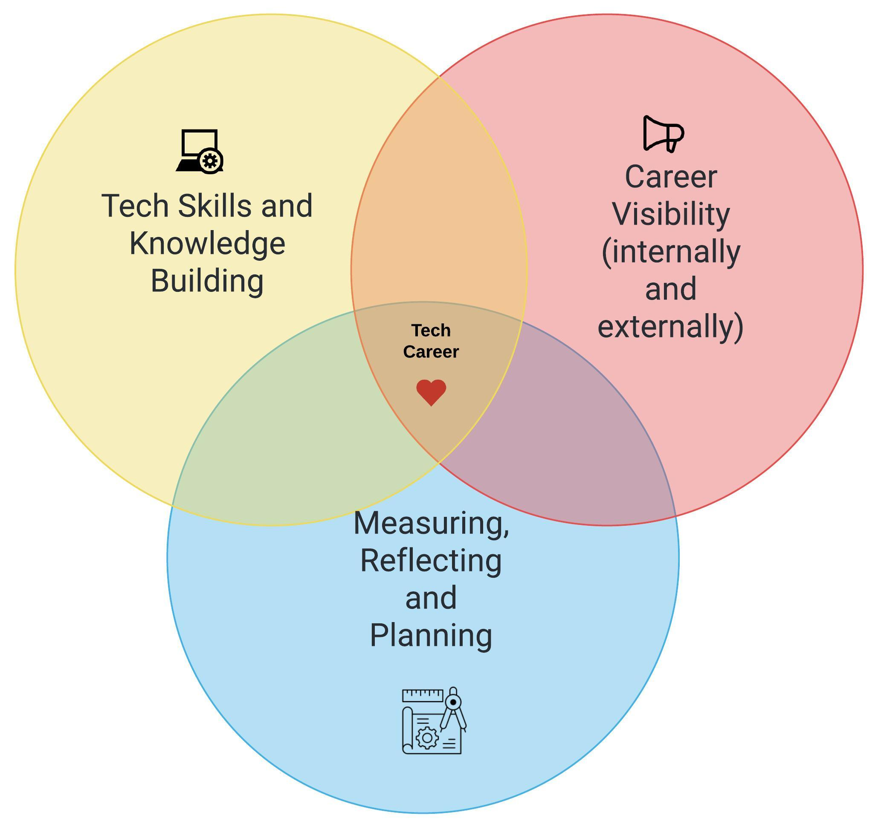
1.
2.
3.
Our agenda

Slide 12
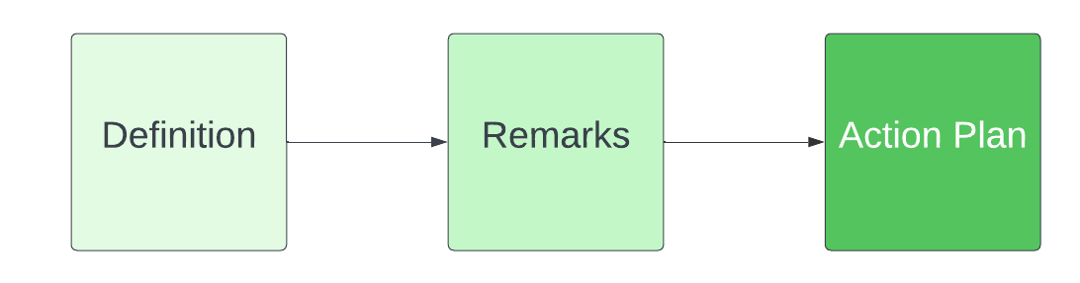



Breakdown of each topic
The idea
The insights
The call to action

Slide 13

Tech Skills and Knowledge Building
Building a rock solid foundation

Slide 14
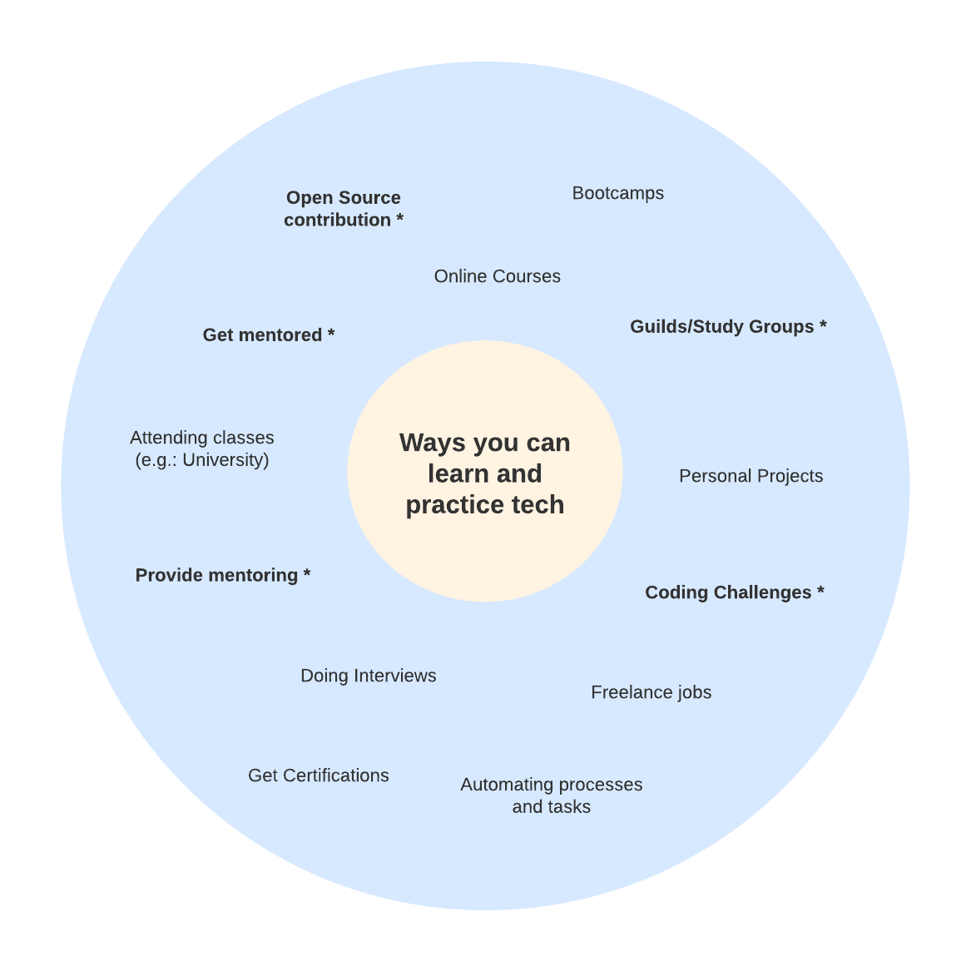

A few ideas you can grab to skill up!

Slide 15
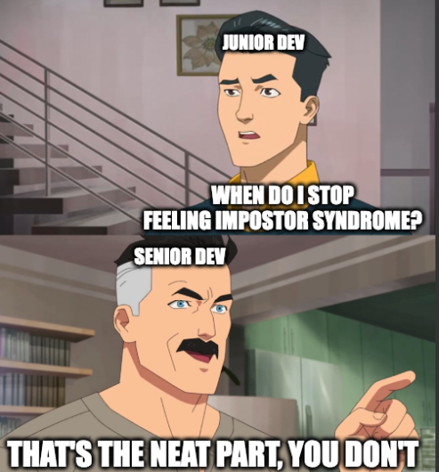
Being Mentored
Definition:
Remarks:
Action Plan:
- Find a specific topic/tech
- Choose a skill
- Match it with a project/goal
- Look everywhere
- Be a DEDICATED mentee
- Make contact
- Possible mentors are everywhere

Slide 16
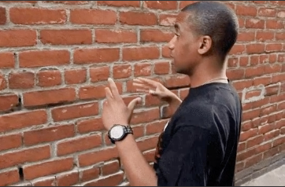
Being THE Mentor
Definition:
Remarks:
Action Plan:
- Get hands on
- Adopt a mentee
- Review what you know
- Offer help
- Make it worth your time
- Set a development goal
- Plant the seed

Slide 17
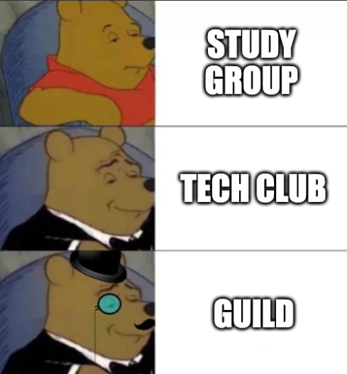
Guilds / Study Groups
Definition:
Remarks:
Action Plan:
- Build shared interest
- Identify areas of interest
- Have a frequency
- Join or Create a guild unofficially
- Advertise it
- Participate actively
- Propose creative events

Slide 18
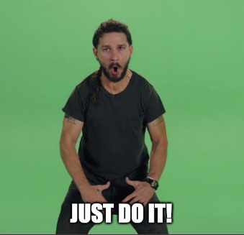
Code Challenges
Definition:
Remarks:
Action Plan:
- Awesome prep for interviews
- Google „coding challenge”
- Stretching problem-solving muscles
- Pick one and sign up
- Start a track or challenge
- Not confortable linking it to your name? Anon-account!
- Do it the ”Duolingo” way

Slide 19
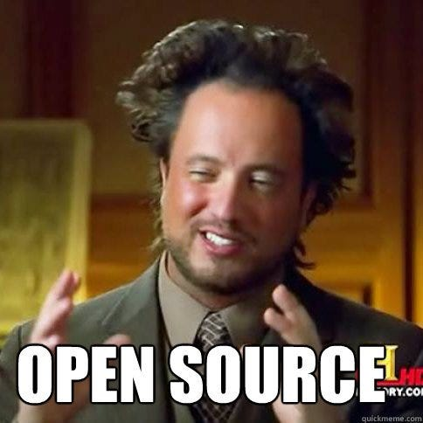
Open Source Contribution
Definition:
Remarks:
Action Plan:
- Choose what and who you work with
- Explore github.com/topics, /trending, /collections…
- Ignite a new passion
- Fork a repo, push a change
- Do it at your own pace!
- …or start your own project ☺
Check out Marcin Lewandowski’s Ignite Talk slides (on source)
- „Good first issue” tag
- Not a coder? There are other ways to help

Slide 20
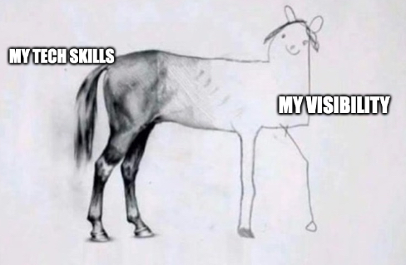
Career Visibility
Don’t be a hidden gem!

Slide 21


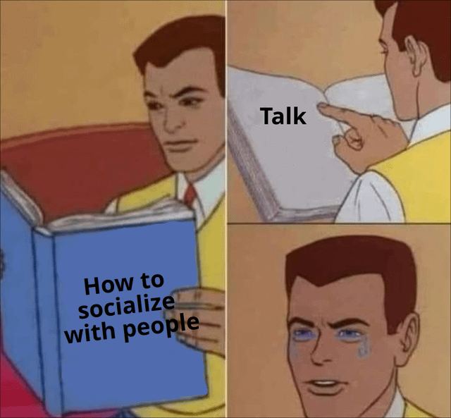
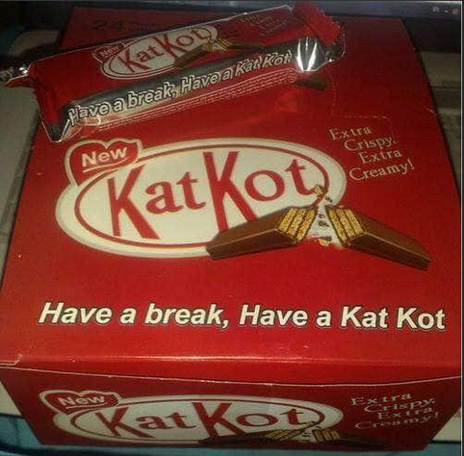
„Visibility”
What is NOT the point:

Slide 22
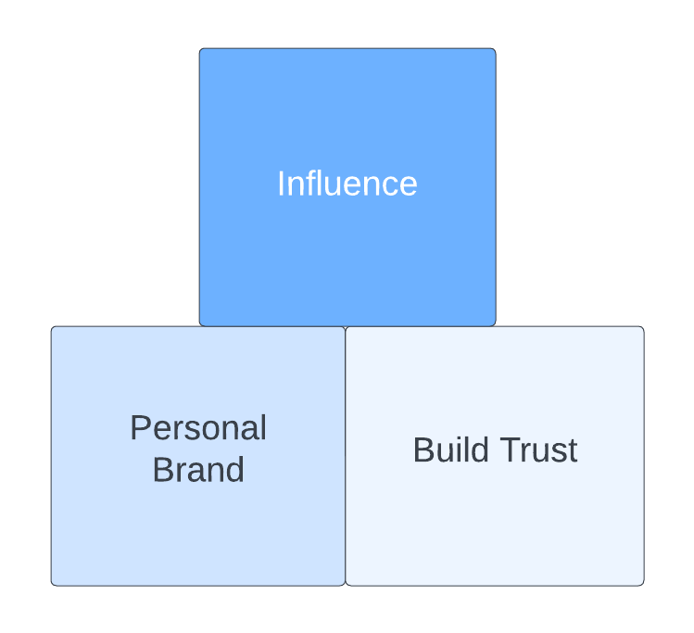
„Visibility”
What the point actually is:

Slide 23
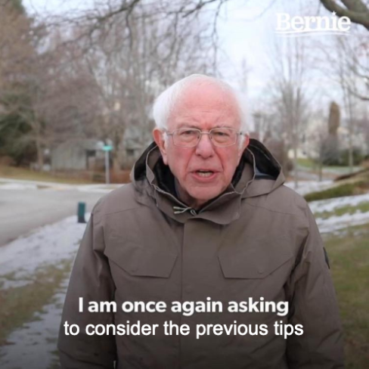
Leverage Previous Tips
Definition:
Remarks:
Action Plan:
- Mentoring creates connection
- Start with one of the ideas from the last sessions
- Being active in a guild builds visibility
- Open-source widens your network
- Share your wins

Slide 24
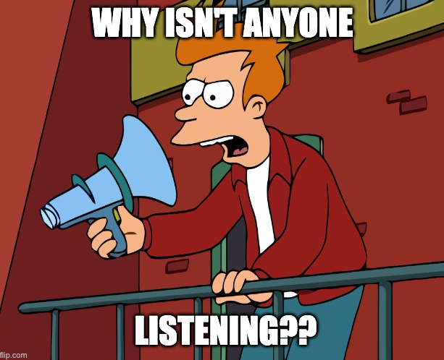
Communicate Better
Definition:
Remarks:
Action Plan:
- Recognize it as any other skill
- Identify one thing you can improve
- Find your weak spot
- Identify one preferred method
- „Do you want me to draw it?”
- Pay attention how others do it
- Learn one new thing and try to apply it
- Apply different strategies
- Use GenAI to assist you (!!!)

Slide 25
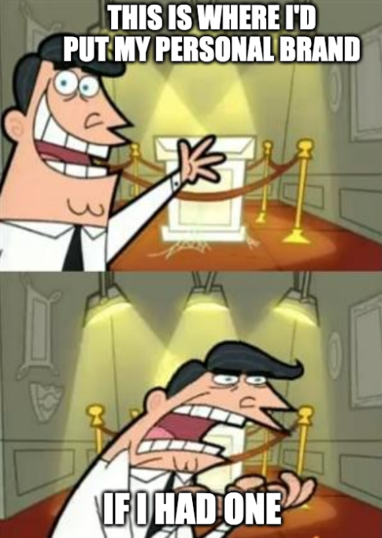
Build your BRAND
Definition:
Remarks:
Action Plan:
- Introspect (who are you anyway?)
- Write down your own brand
- Does it makes sense?
- Be authentic
- Embrace it and leverage it

Slide 26
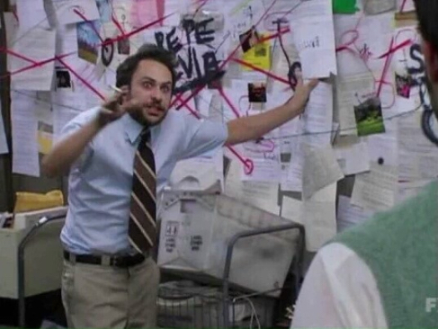
Measuring, Reflecting and Planning
Are you in the right direction?

Slide 27
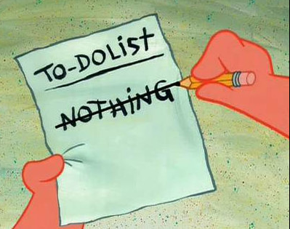
Planning
Definition:
Remarks:
Action Plan:
- Set simple goals
- Set one goal for yourself
- Gather feedback
- Choose a method and register it
- Keep notes
- Set a reminder to review
- Make it visual
- Use apps to help you

Slide 28
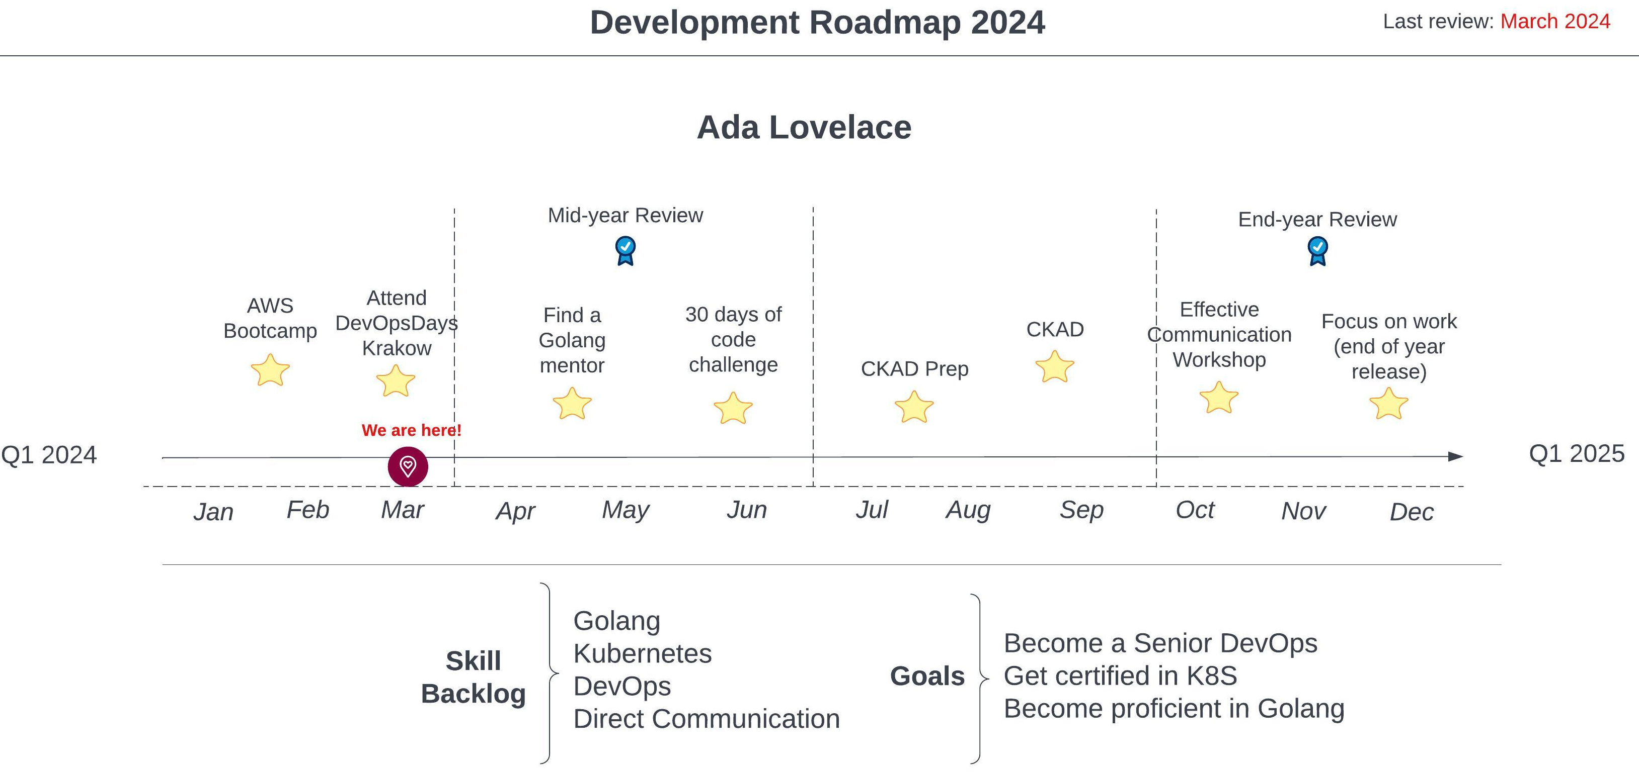

Slide 29

Explore
Definition:
Remarks:
Action Plan:
- Lateral career movement
- Check job descriptions, salaries and reviews
- Rotation / Project changes
- Check for opportunities in your company
- Check a roadmap
- Talk with someone here who does something different than you do
- Seek new trends
- Explore available data

Slide 30
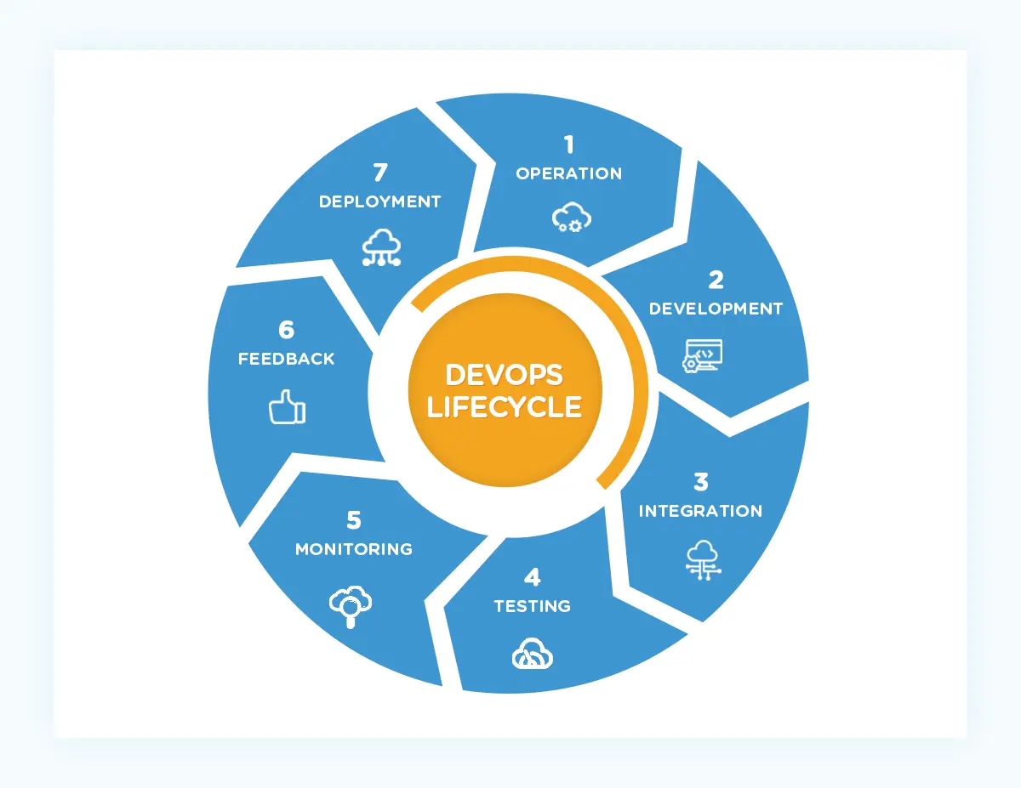
…all right. Now what?

Slide 31
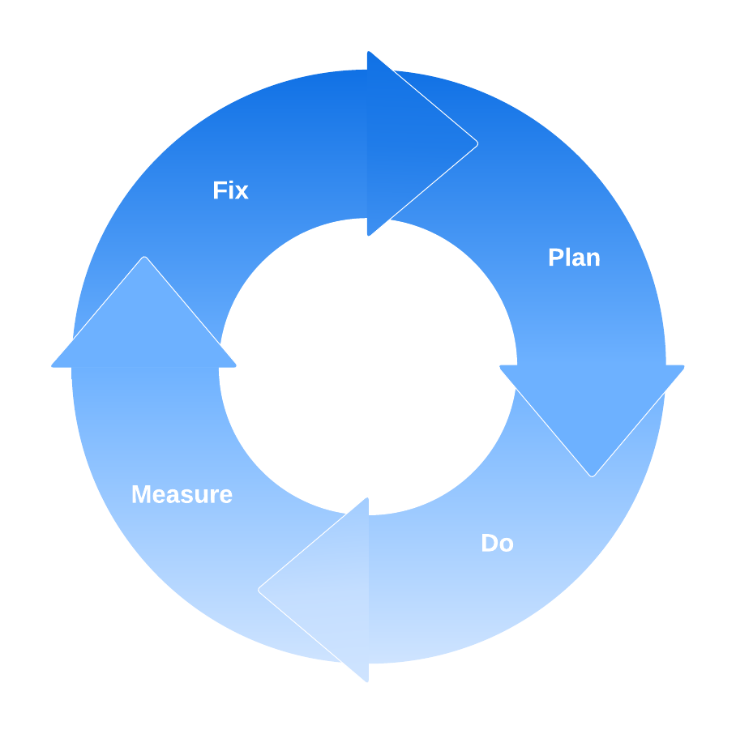
…all right. Now what?

Slide 32
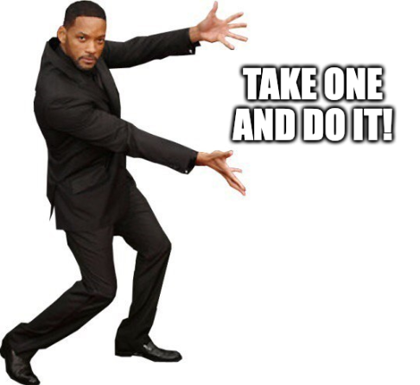
But more importantly!

Slide 33
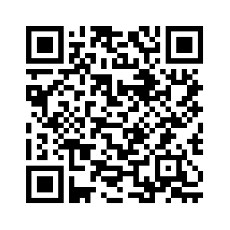
Sources
Human Motivation: Drive – Daniel H. Pink (book/audiobook)
Interpersonal skills: How to Win Friends and Influence People – Dale Carnegie (book/audiobook)
Habits building: Atomic Habits – James Clear (book/audiobook)
Coding challenge : LeetCode.com, HackerRank.com, CodeSignal.com (website)
Communicating with other cultures: The Culture Map – Erin Meyer (book/audiobook)
Cool apps / trackers : Habitica, Daylio, Goalify, etc…
GitHub repo with slides and sources

Slide 34
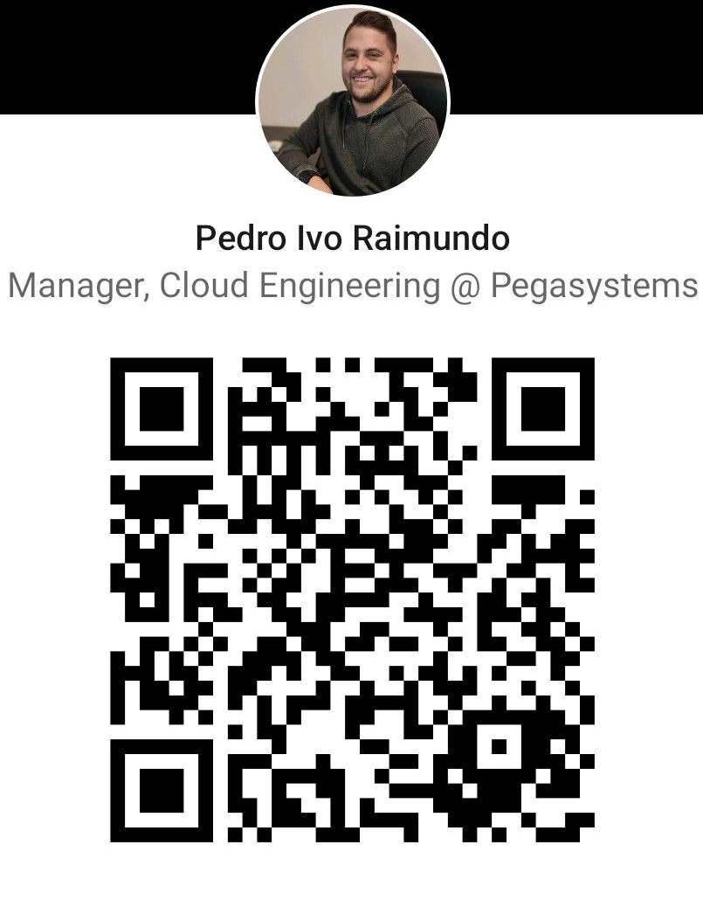
Final thoughts
Thanks for your attention and I hope this will inspire you to try something new!
QUESTIONS? ☺

Slide 35
Thank you, dziękuję, obrigado!
Pedro Raimundo
Pedro.Raimundo@pega.com
25.04.2023
Qubus hotel, KRAKÓW

